Slide 1
Final Presentation
Agon Serifi, Andreas Aeberli,
Elham Amin Mansour, Lea Reichhardt, Martina Kessler

Slide 2
Bonus
Multi-Linear Face Model
DECA - Image to 3D Mesh
DL based landmark placement

Slide 3
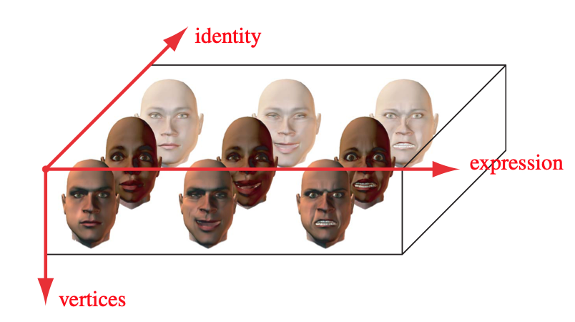
Multi-Linear Face Model (MLM)
Vlasic et al. SIGGRAPH '05
Notes:
We wanted to explore a different Face model called the Multi-Linear Face Model (MLM).
You can think of this model as a PCA in higher dimensions
PCA can be computed with a SVD. But the Data-Matrix we decompose does not have any constraints, meaning whatever order the meshes have in the matrix the result will be the same.
As all have seen in this Project, the PCA of the meshes allow us to play around with the different eigenfaces by changing a coefficient which gives the corresponding eigenface another strength. this results in some meaning full deformation and we can try to give each eigenface a semantic meaning (like; this eigenface determines the length of the nose, or this makes a mesh smile).
But if we look more accurate to the last example we see that actually is not only the smile that changes but also other parts of the mesh which cause a change in the identity. So although this eigenvector clearly influences if a mesh smiles or not, it does not only change the expression.
a MLM applies the idea of PCA to a new dimension.
Instead of having some random ordered mesh matrix, we construct a 3-Mode-Tensor of our data. where we order one dimension the identities on the other all varieties of the expressions and lastly the vertex positions.
on this 3-Mode tensor we can now apply a Higher-Order SVD (HOSVD) on the identity and expression mode. the decomposition can be similarly to the single dimension PCA be seen as a set of Eigenfaces. but now we do not get a single set but two separate sets. one controlling the identity mode the other the expression mode.
this allows us to change the two modes separately and in a more controlled way.
So we implemented a MLM from scratch in Python. And will present some results in the following slides.

Slide 4
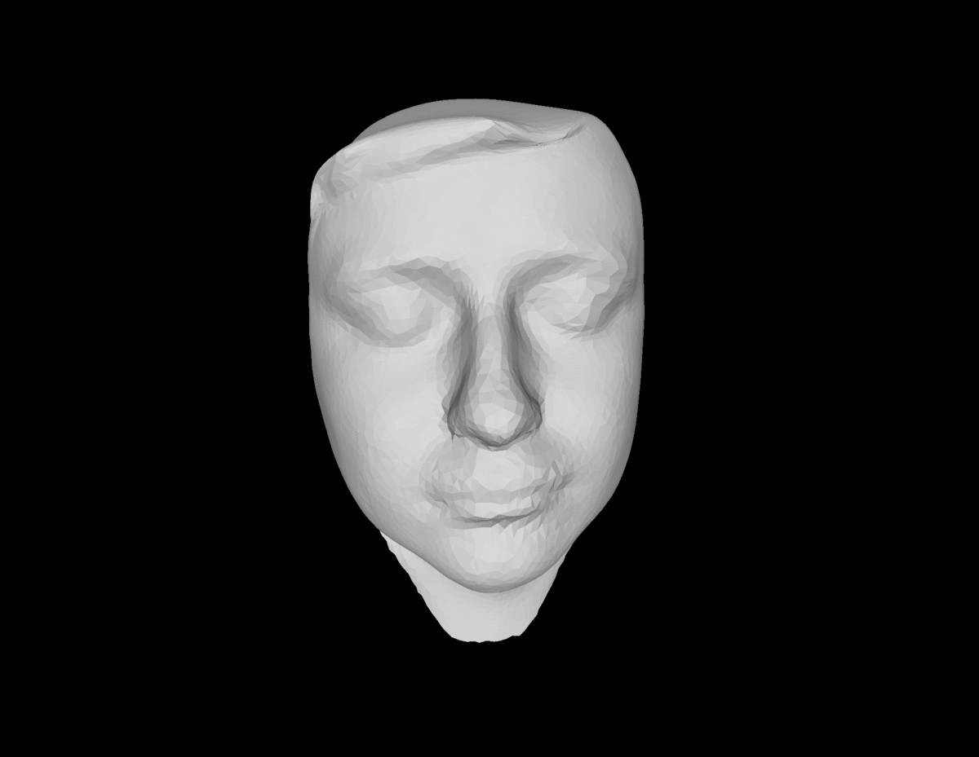
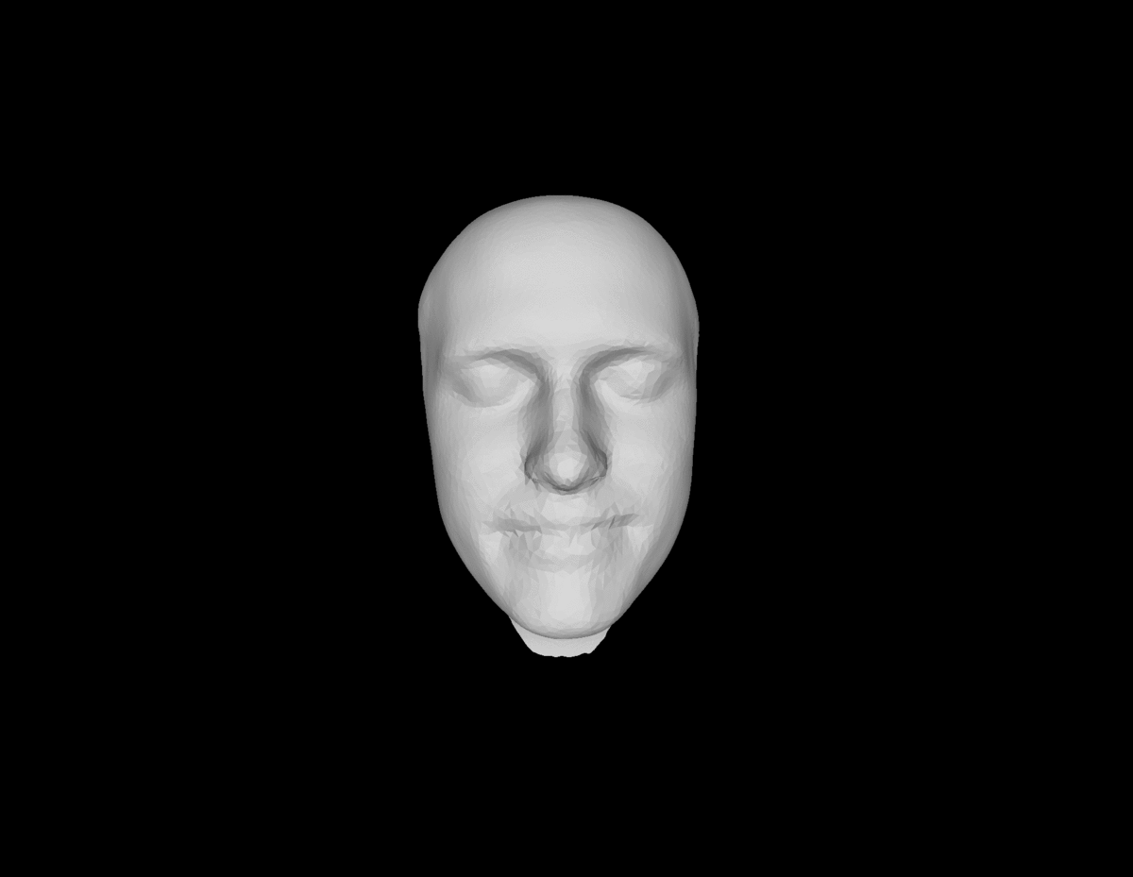
MLM space
morphing
generation
Notes:
we can also morphe between different identities. This really morphes only through the identity so the expression in the morphing is always the same!
with this decoupling of identity and expression we are able to generate new identities and let each one smile smile :)
To keep the model able to generate arbitrary scaled meshes, we backed the mean mesh into the MLM space and did not subtract it in the beginning.

Slide 5
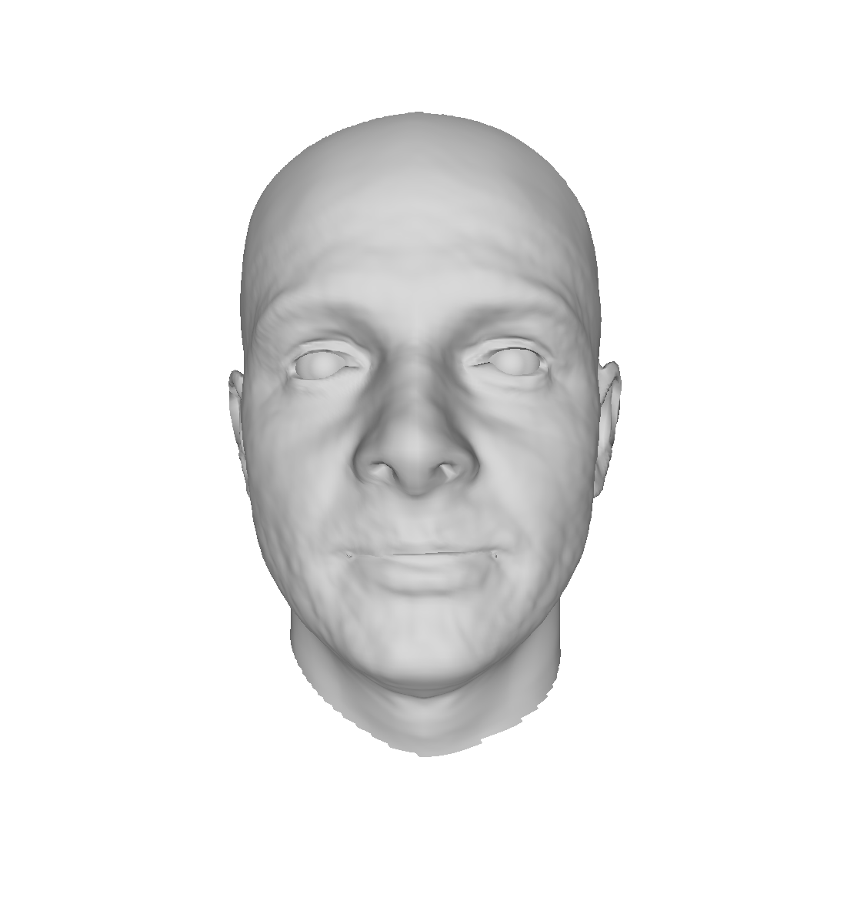
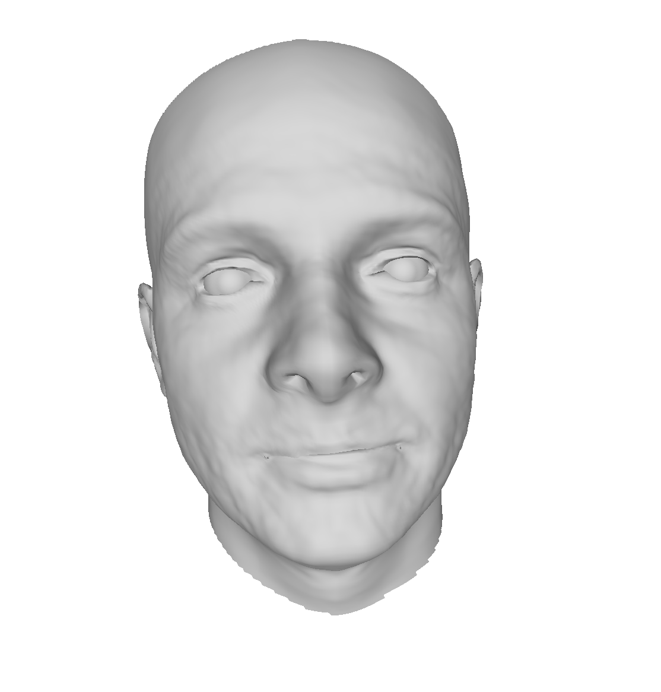
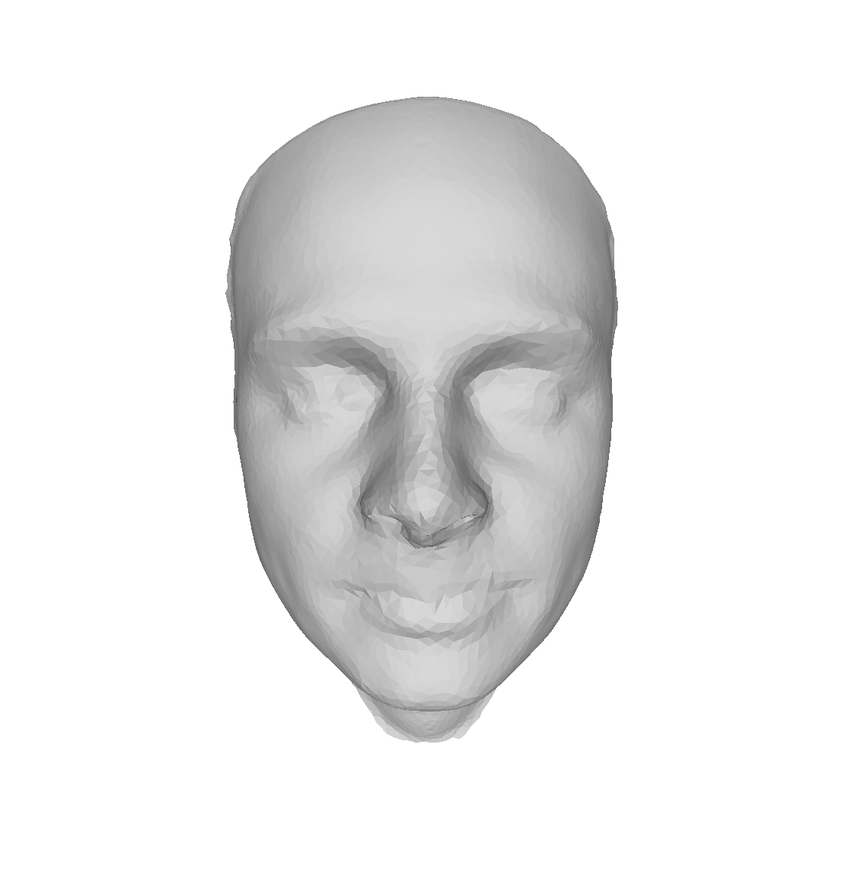
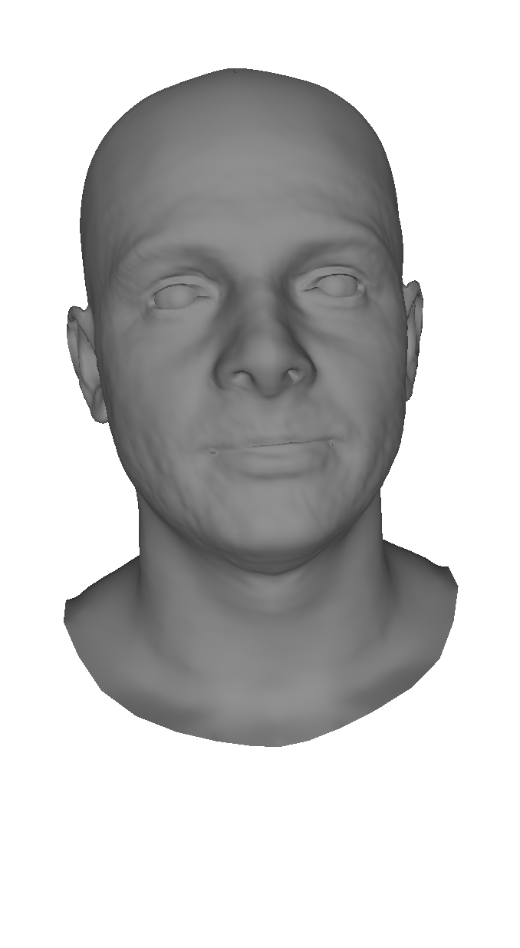

DECA - 3D Mesh Reconstruction from Single Image
cut
align
warp
Project Pipeline
DECA
Feng et al. SIGGRAPH '21
Notes:
We reconstructed our meshes using DECA which is a very recent SOTA DL method for 3d reconstruction. it takes as input an single Image and infers parameters for a large face model. this face model takes similary to the Multi linear model a different set of parameters for identity and expression. these parameters are then used to reconstruct the 3D mesh.
So DECA itself is a deep learning model which can predict such parameters by using heavily convolutional networks for analysing an image.
We used DECA in the following way to generate our 3d meshes...

Slide 6
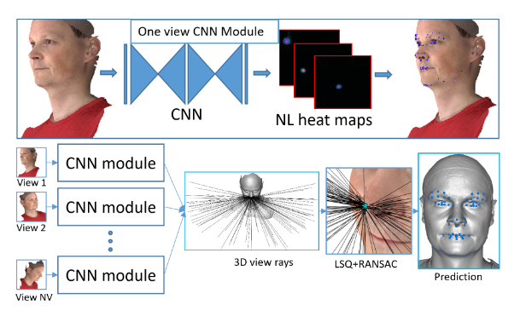
Deep learning based landmark placement
Notes:
One way to streamline the pipeline is to replace the landmark picking done by humans with a deep learning based approach. Deep learning advances in geometric deep learning with 2D facial landmark placement inspired this work.
Novelty: Multi view rendering of mesh, resulting trained ray is put together for 3D landmark placement. Adaptation for our work: Model predicts landmark points, not vertices. Thus an additional step when using the landmarks is required, where a spatial index search checks for nearest vertex index.

Slide 7
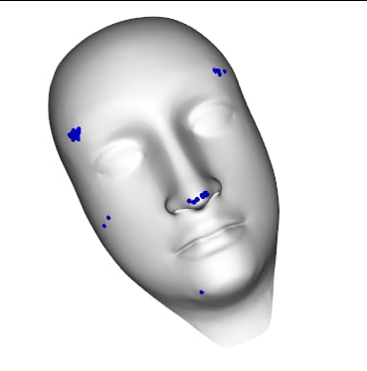
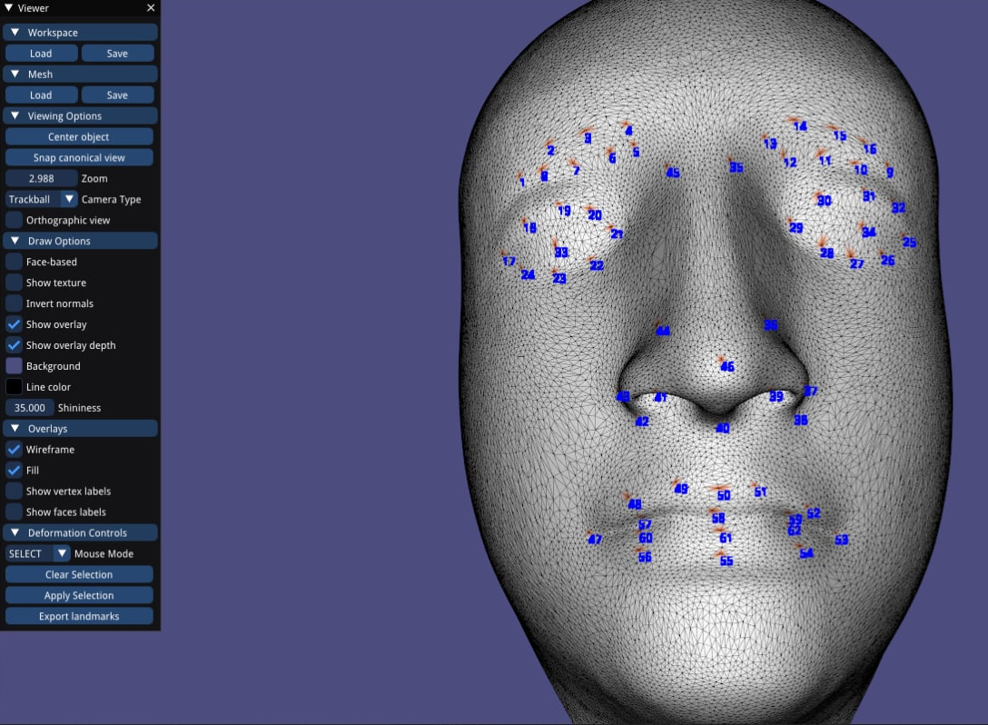
DL landmark placement - template obstacle
Notes:
Challenges in our project: The Deep learning model has problems with finding landmarks on the templates. It seems to be trained on real face scans only and thus performs really poorly on the templates -> manually picked corresponding 73 landmarks.

Slide 8
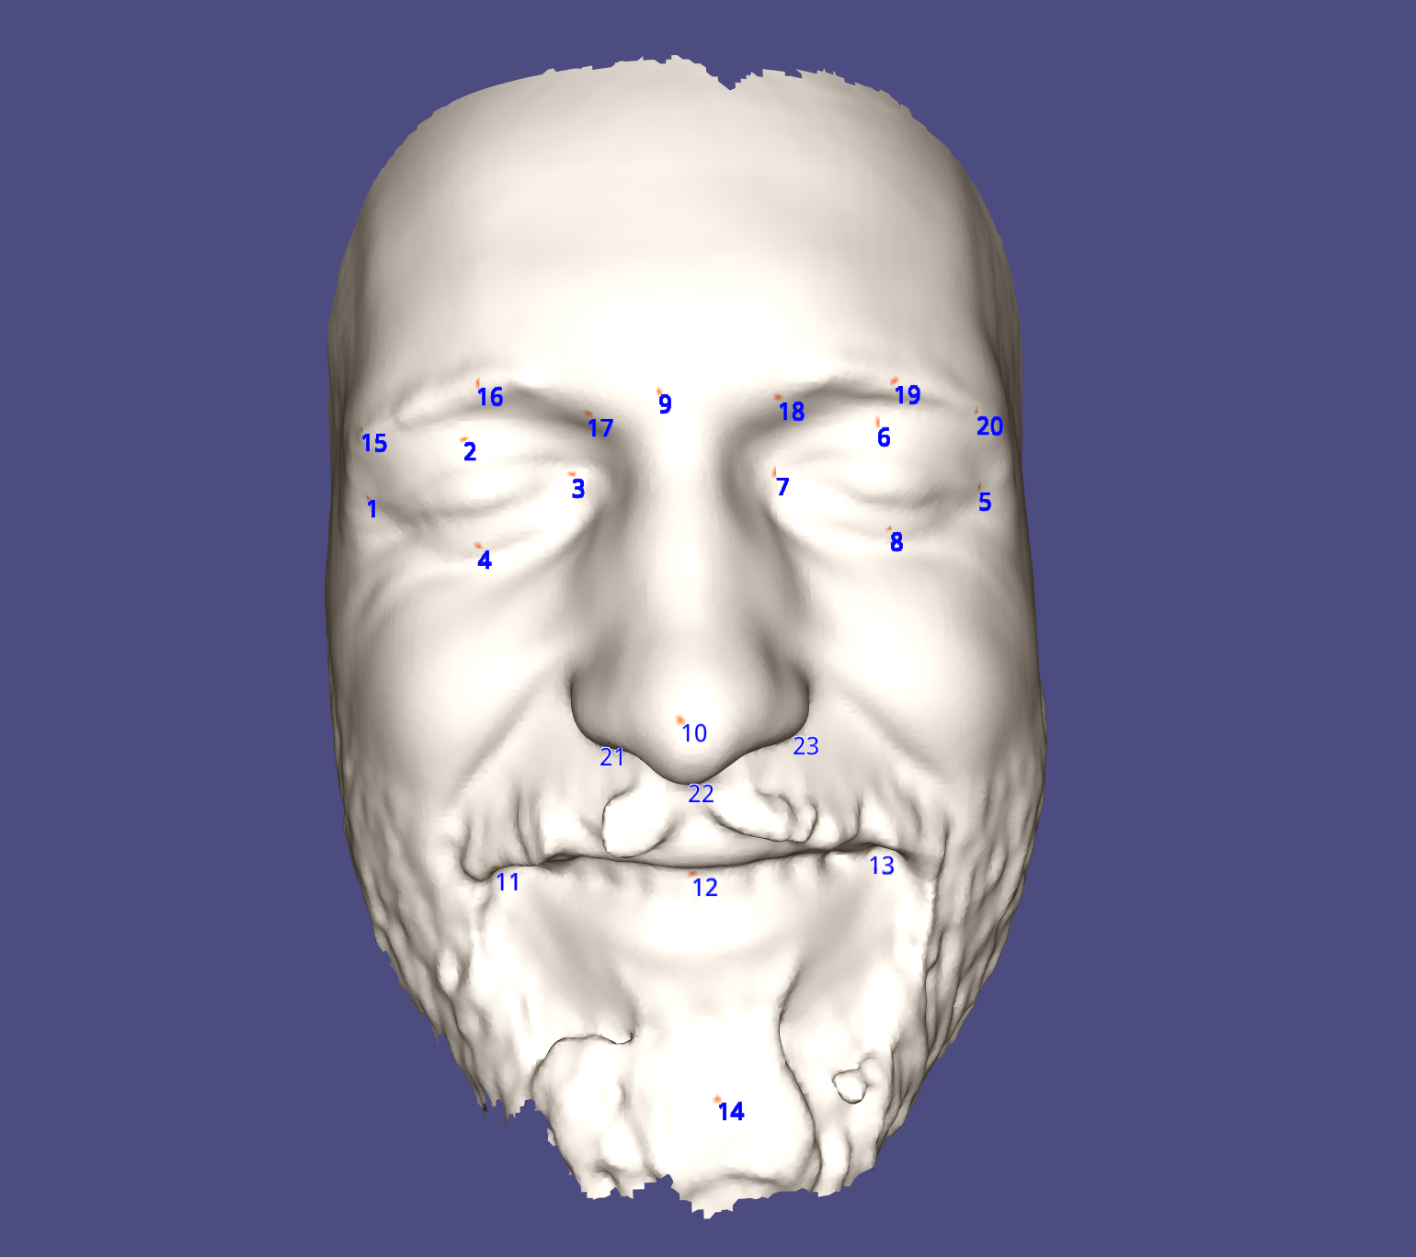

Slide 9
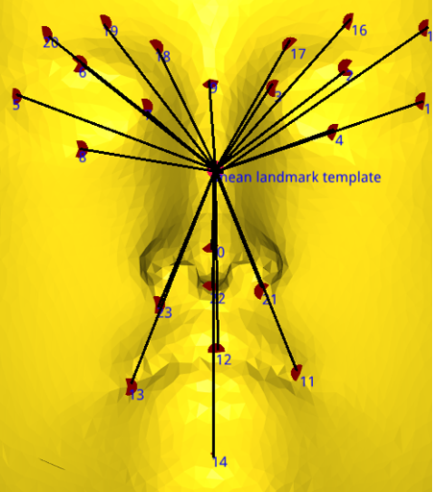
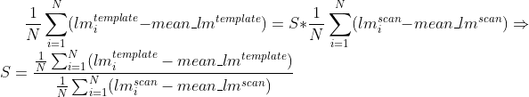
Optimal Scale Factor for Rigid Alignment
Notes:
I set this slide to “skipped” such that it will not be shown in the presentation, because I think that we don’t have time to show it. I can explain this part if they want to have more details about how we scaled the meshes.
Here you can see the template face with the landmarks as red dots. The mean landmark is located where all the black lines intersect. The face is shown from the back because the mean landmark lies behind the surface of the mesh. For better visualization, the normals are inverted.
The scaling factor is determined such that the average distance to the mean landmark is equal for both the template and the scan. For this, the length of all black lines, which is the distance between a landmark and the mean landmark, is calculated, summed up, and then divided by the number of landmarks. The same is done for the scan. Then the scan is scaled such that the average distance to the mean landmark is the same for the scan and the template. You can see what I just said in the formula on the right.
The optimal rotation was found using the SVD decomposition as shown in class.

Slide 10
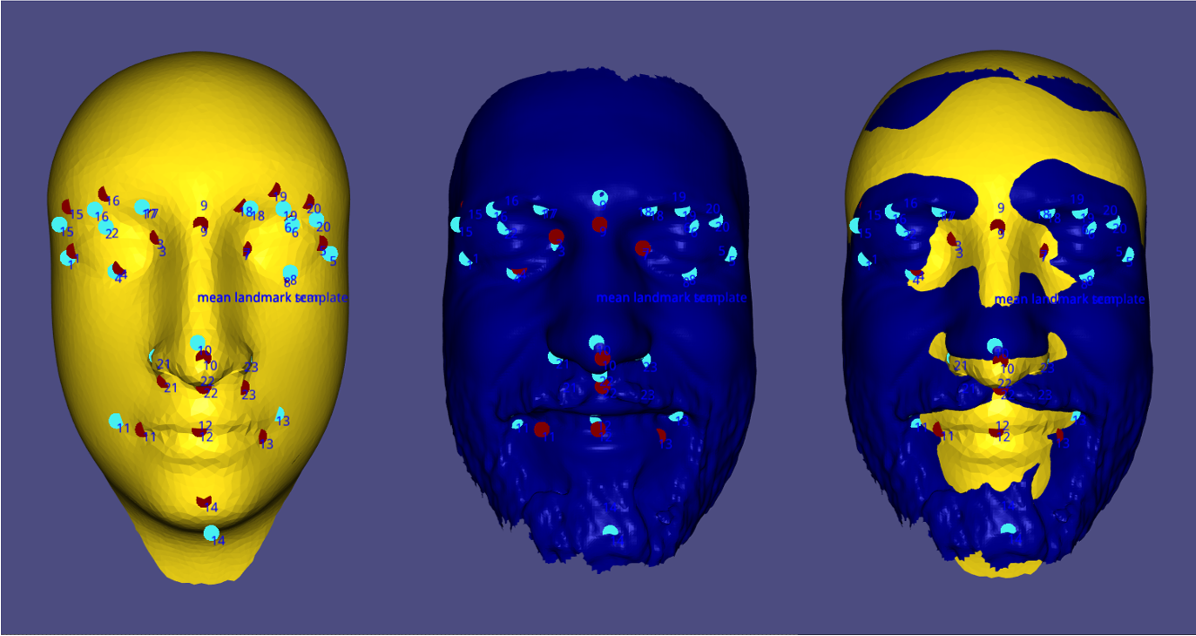
Rigid Alignment
Notes:
Here is the result of the rigid alignment.
red dots: landmarks of the template
cyan dots: landmarks of the scan
left mesh: template
middle mesh: scan
right mesh: template (orange) and scan (blue) overlaid
Not all landmarks can be seen because some are behind the surface of the face. It can be seen that the template and the scanned face are nicely aligned and it worked well as the input for the warping.

Slide 11
Non-rigid alignment for lower resolution template

Slide 12
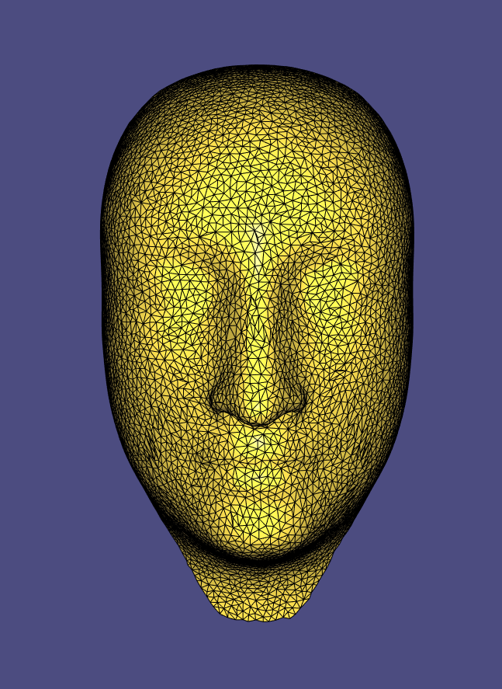
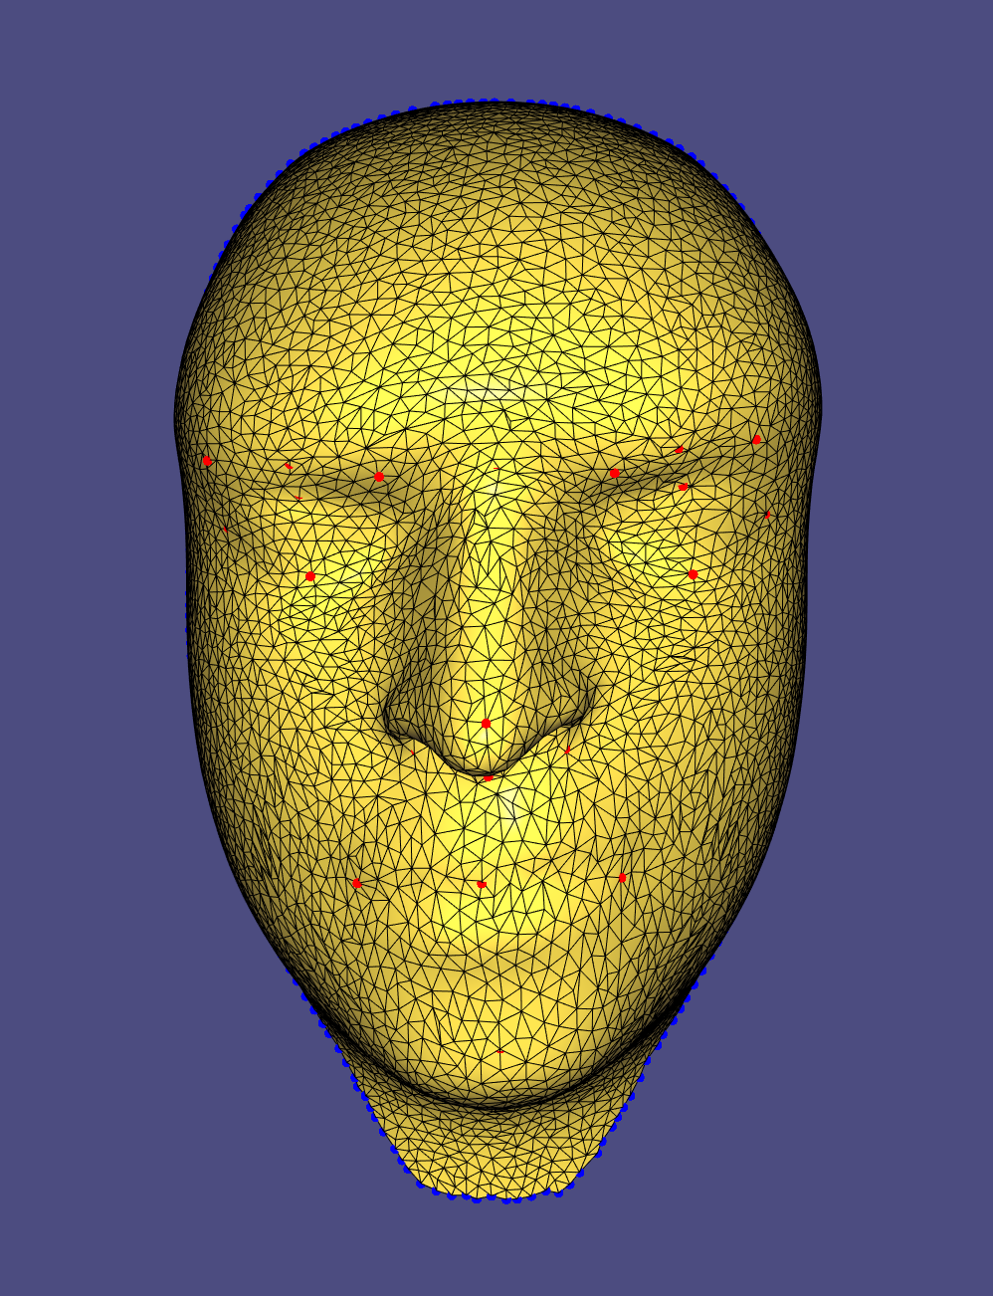
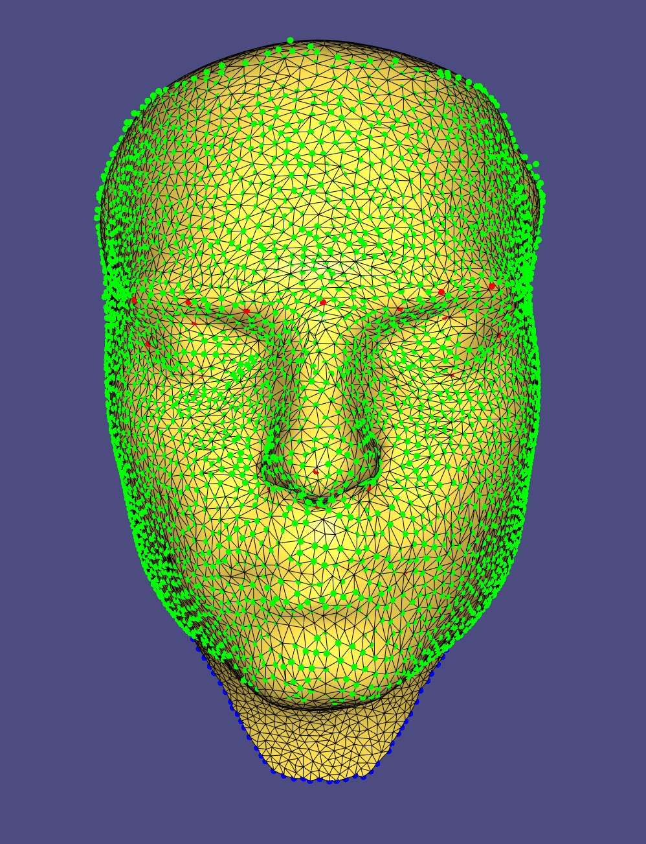
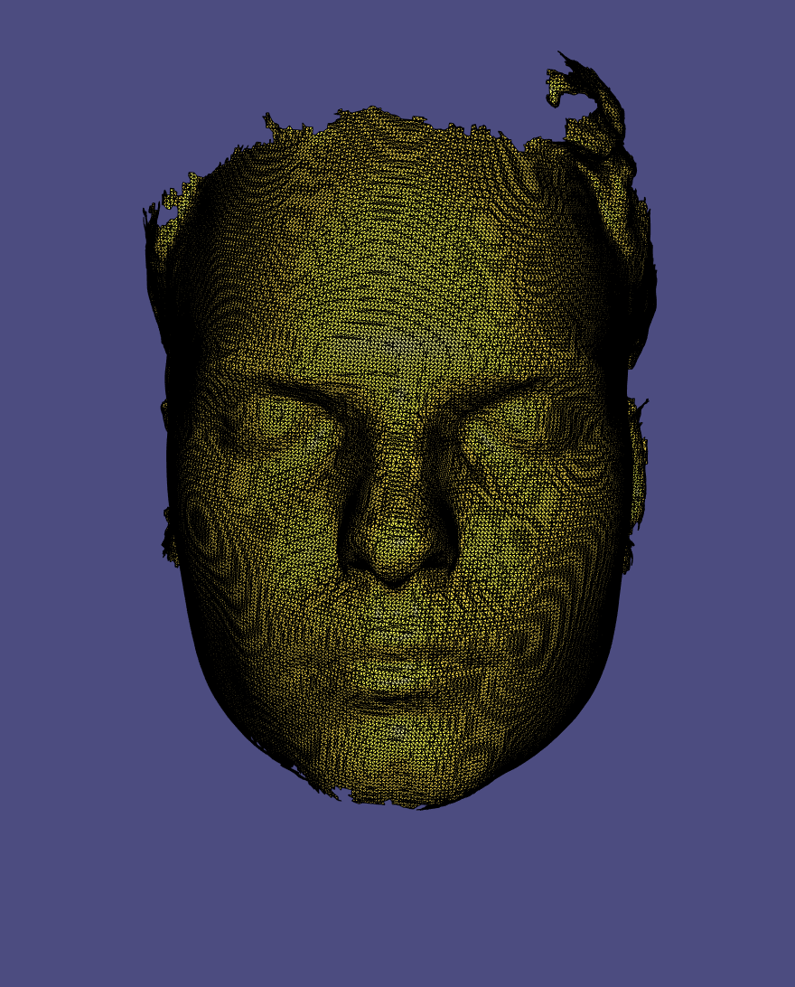
template
after 5 iterations with only landmark constraints + boundary constraints
after 5 iterations with close point constraints + landmark constraints + boundary constraints
Scan

Slide 13
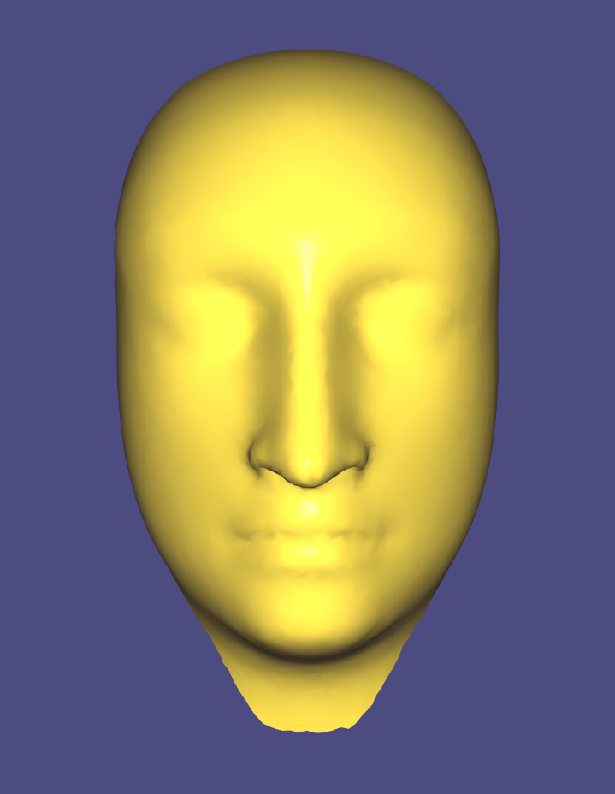
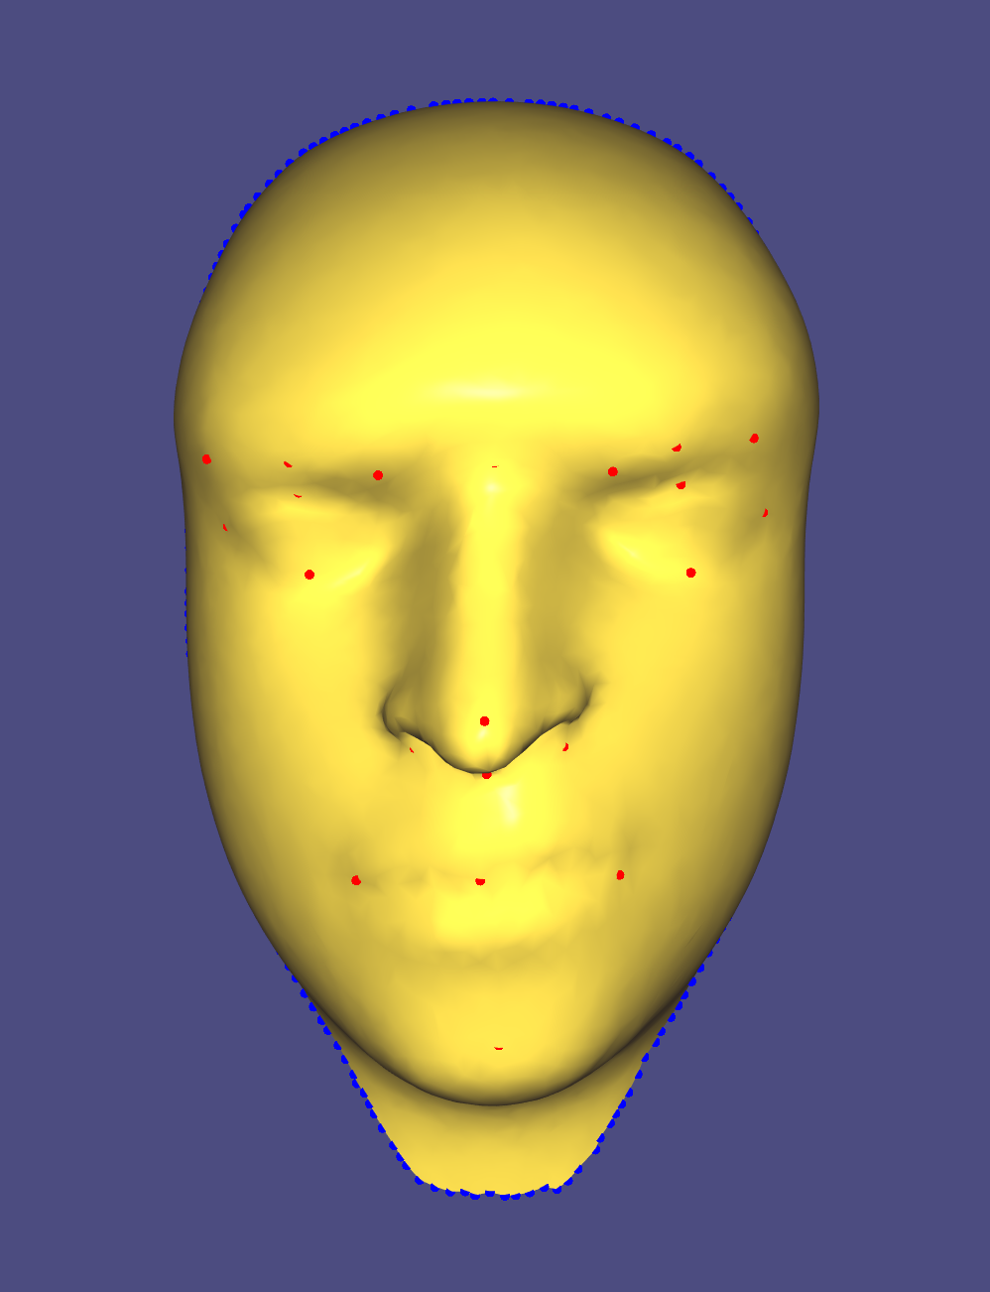
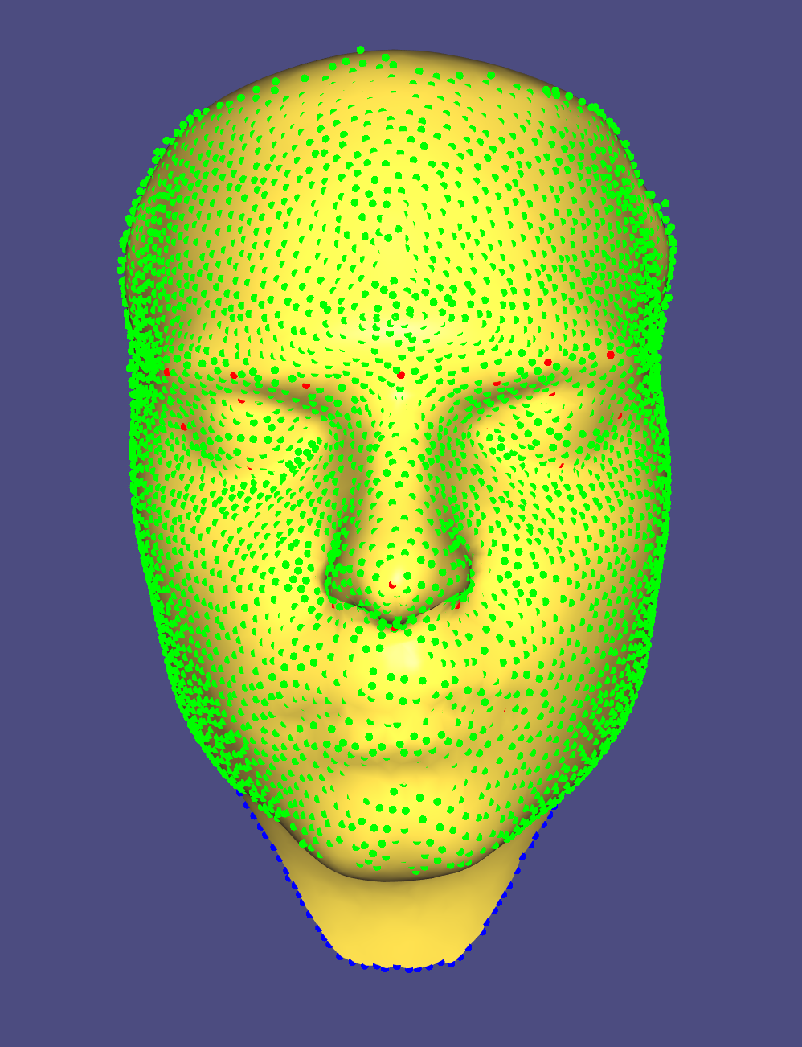
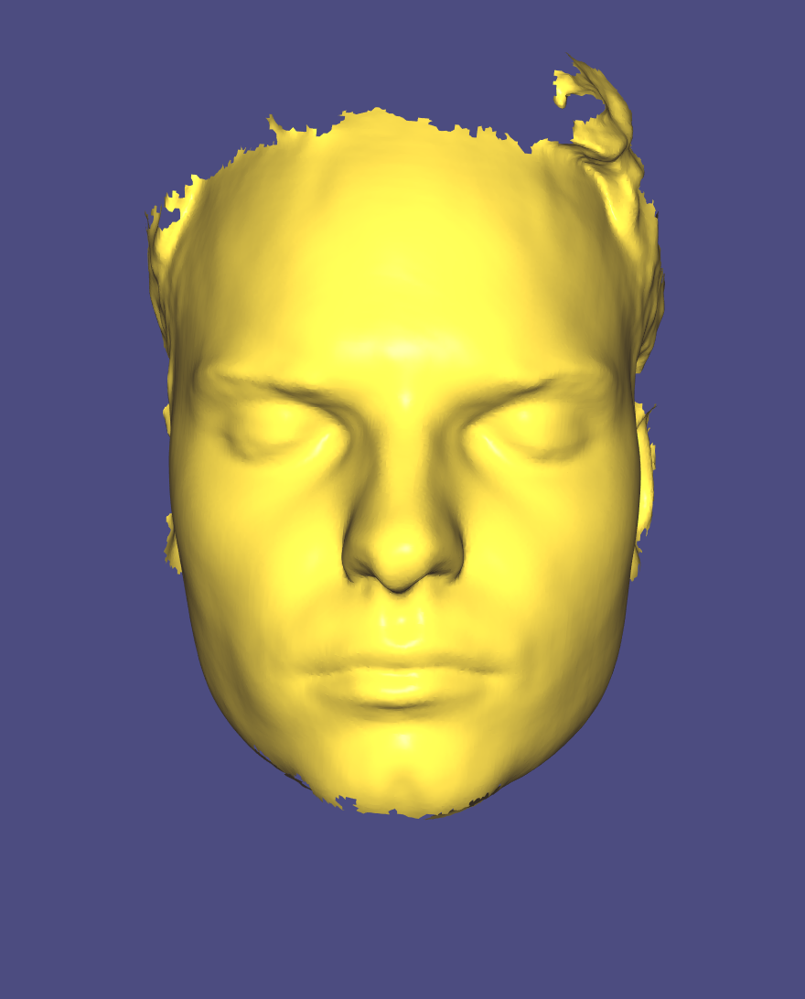
template
after 5 iterations with only landmark constraints + boundary constraints
after 5 iterations with close point constraints + landmark constraints + boundary constraints
Scan

Slide 14
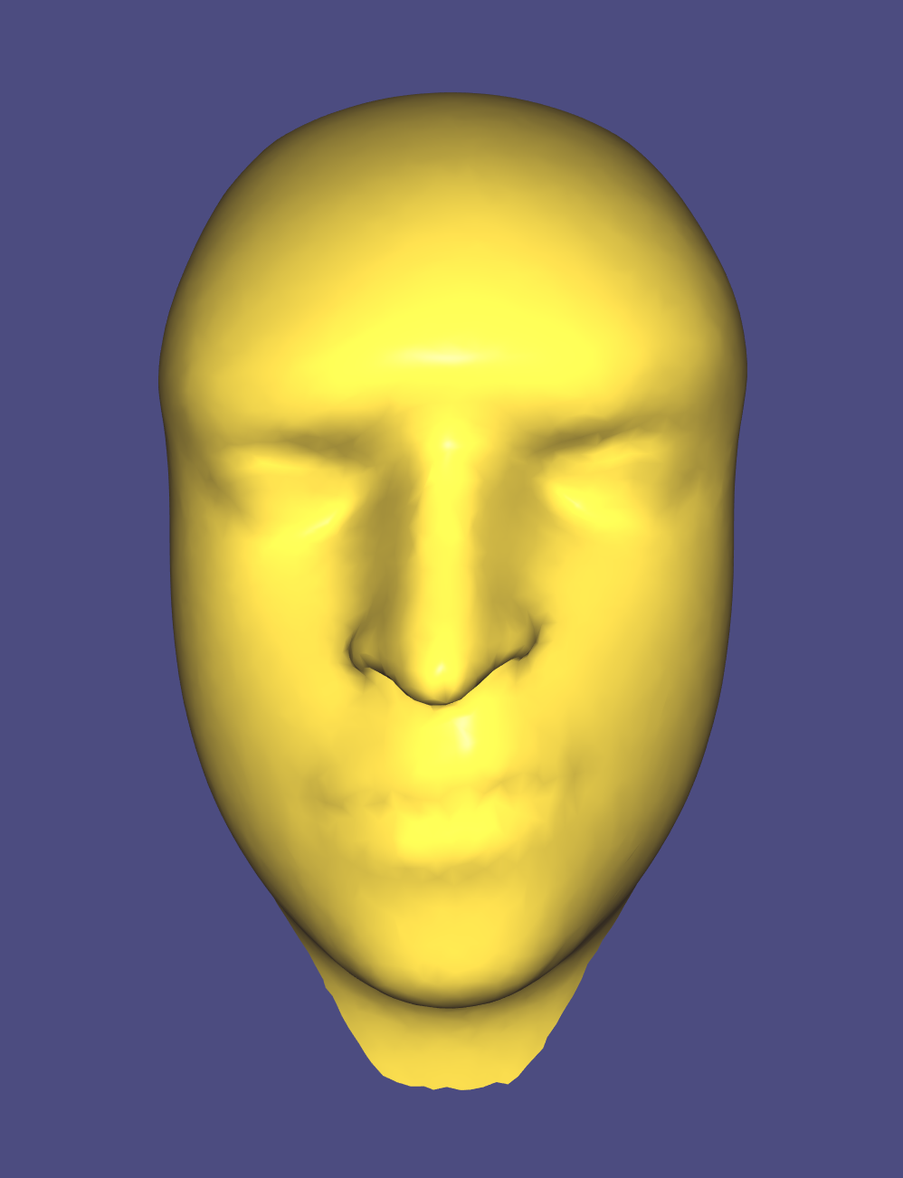
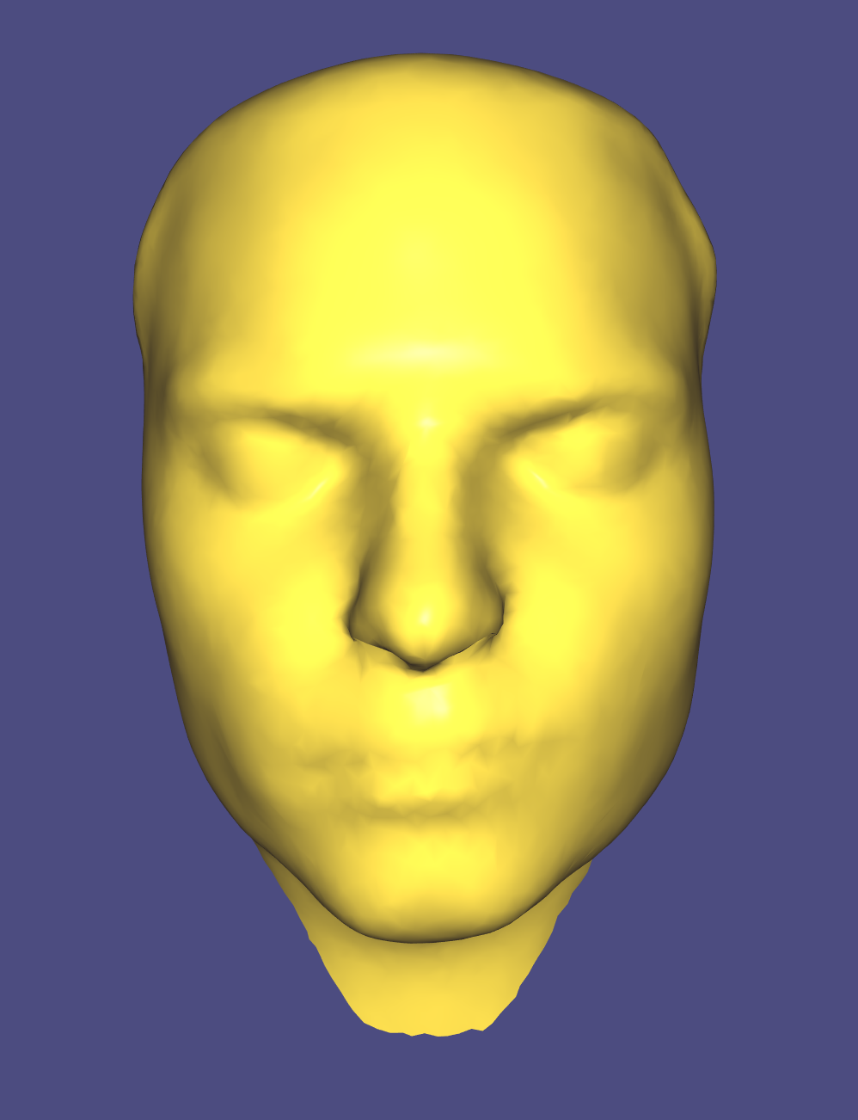
template
after 5 iterations with only landmark constraints + boundary constraints
after 5 iterations with close point constraints + landmark constraints + boundary constraints
Scan

Slide 15
Non-rigid alignment for high resolution template

Slide 16
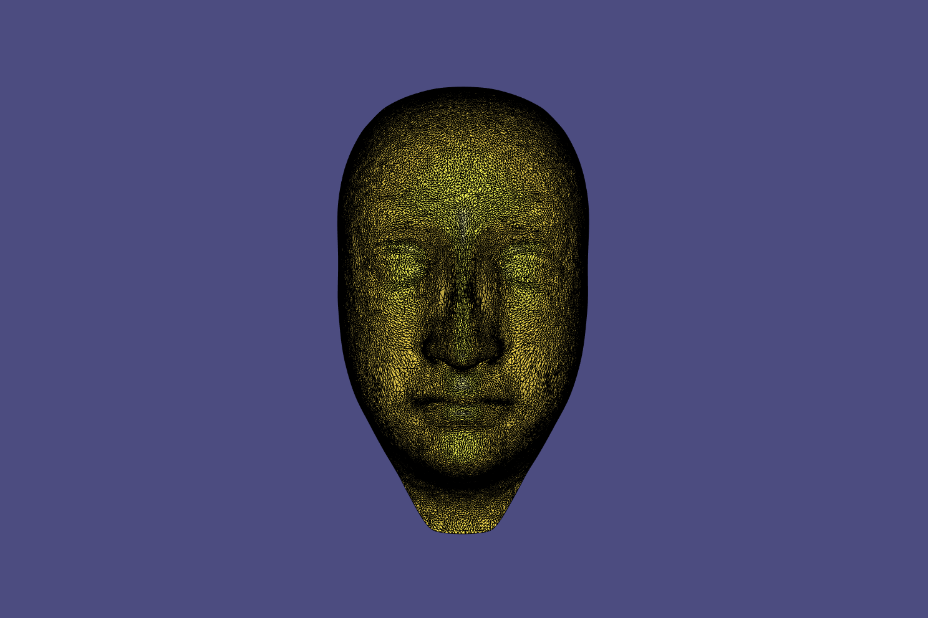
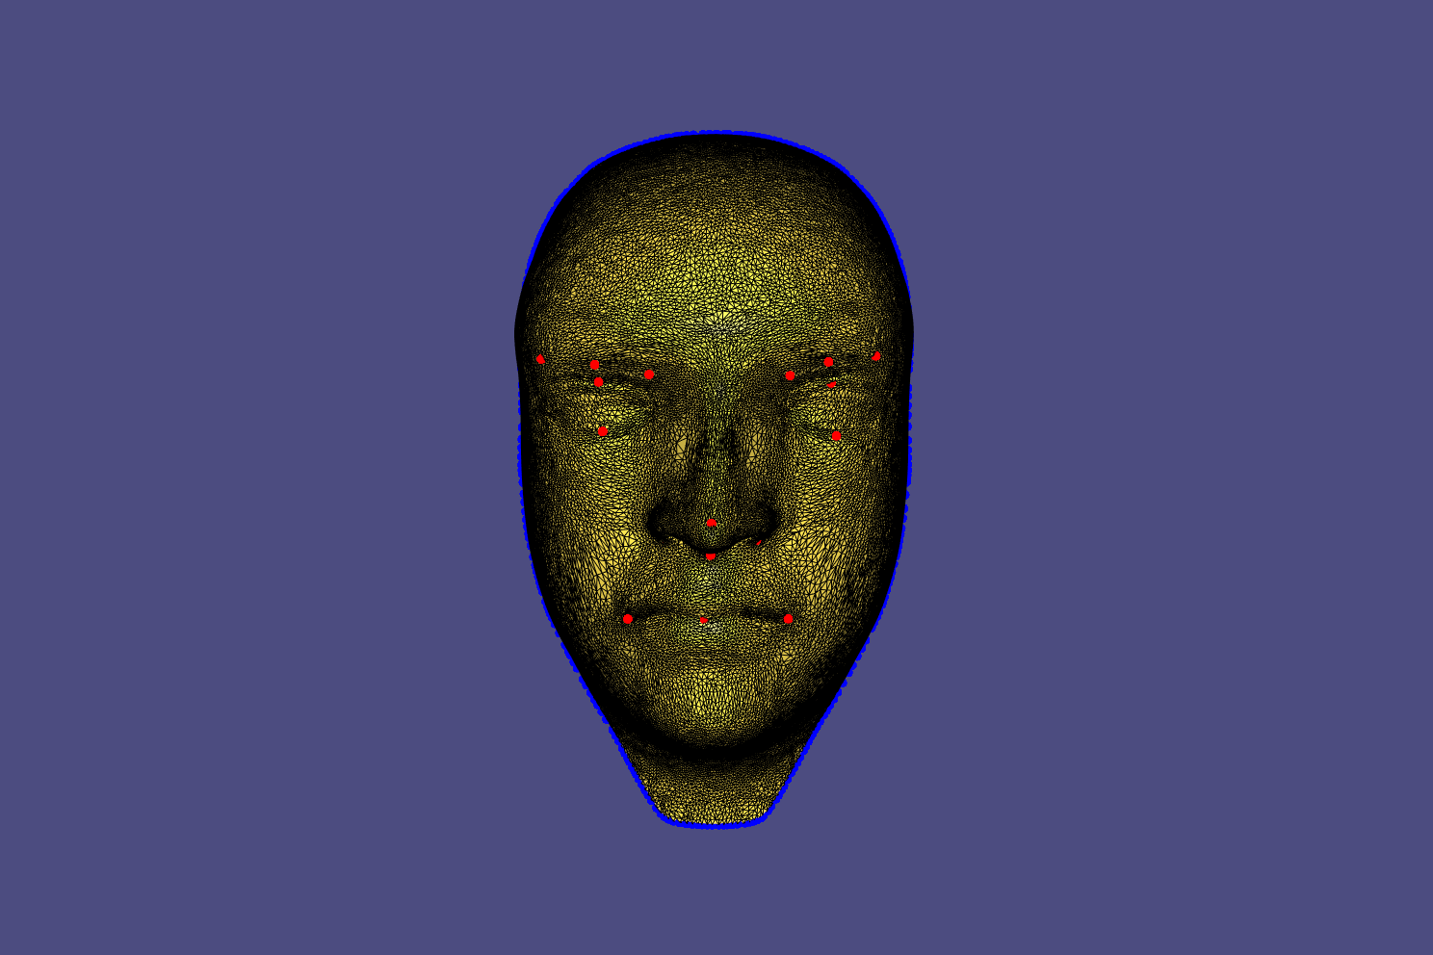
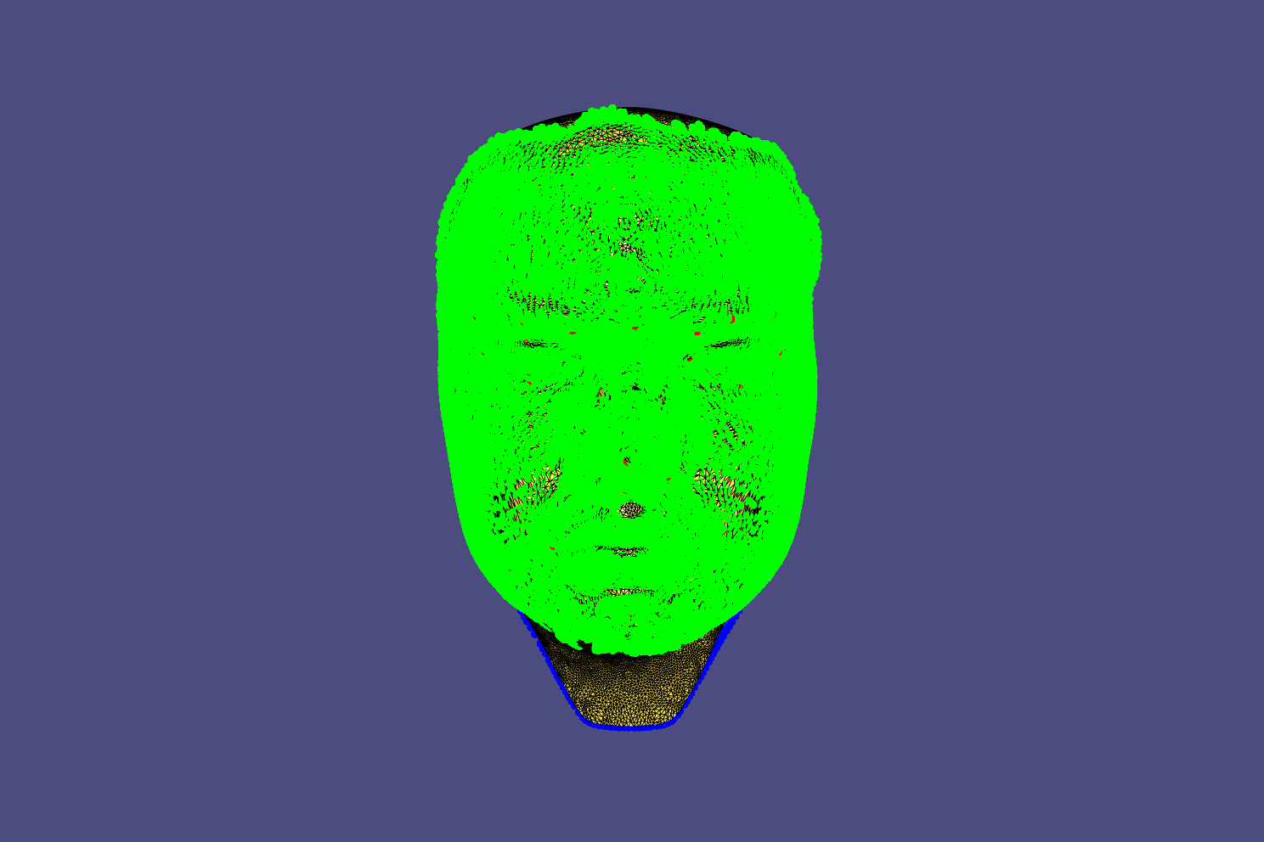
template
after 5 iterations with only landmark constraints + boundary constraints
after 5 iterations with close point constraints + landmark constraints + boundary constraints
Scan

Slide 17
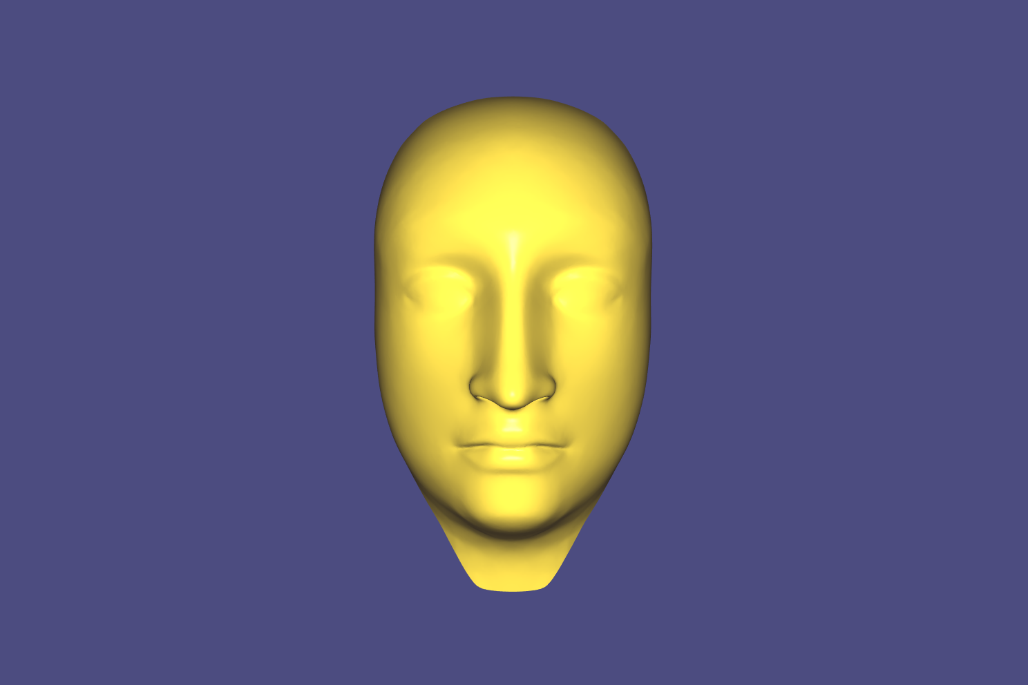
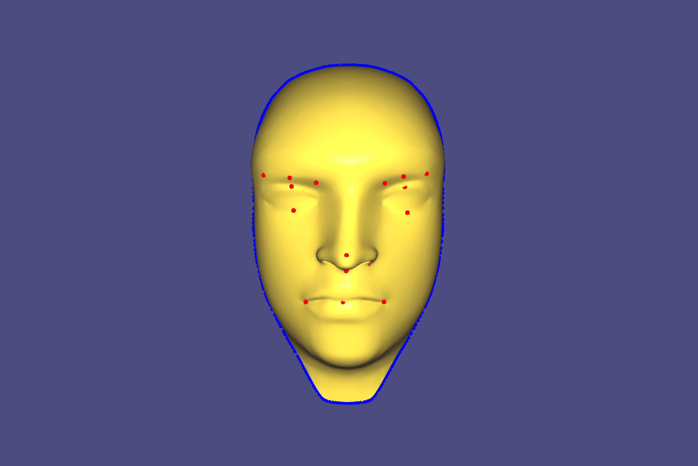
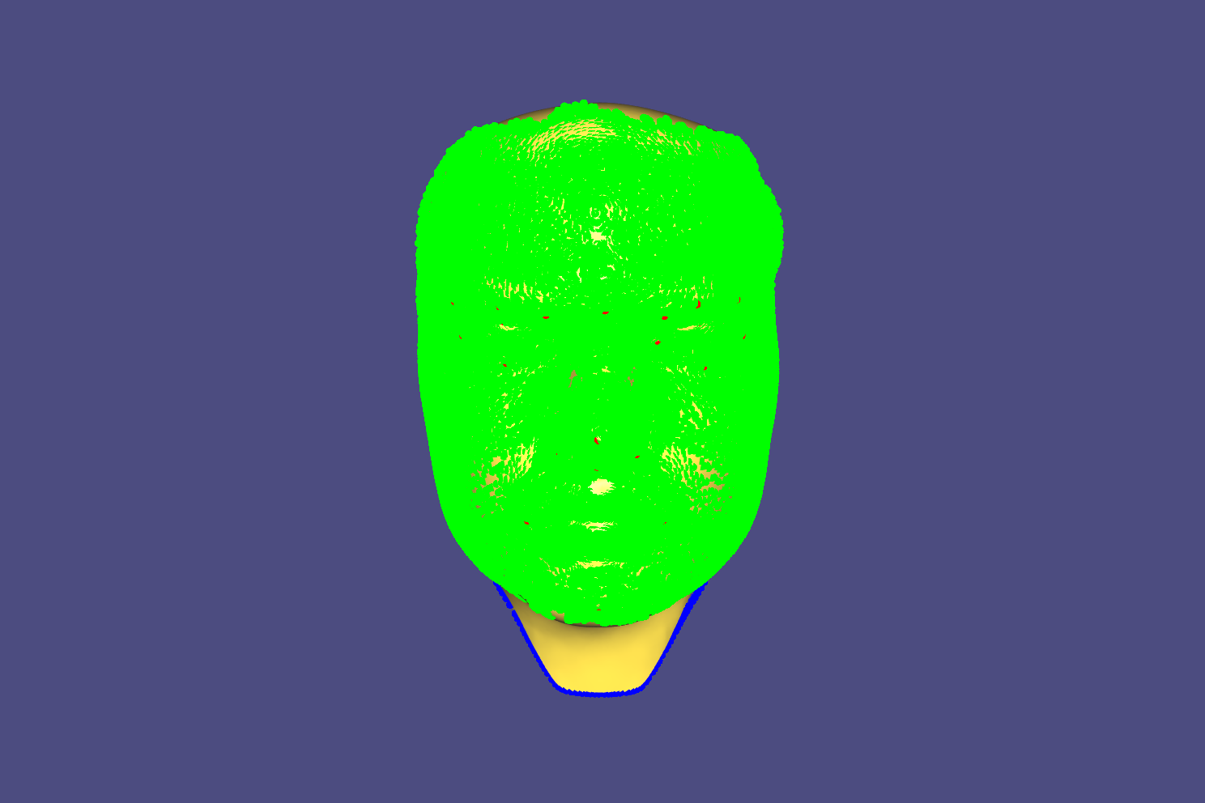
template
after 5 iterations with only landmark constraints + boundary constraints
after 5 iterations with close point constraints + landmark constraints + boundary constraints
Scan

Slide 18
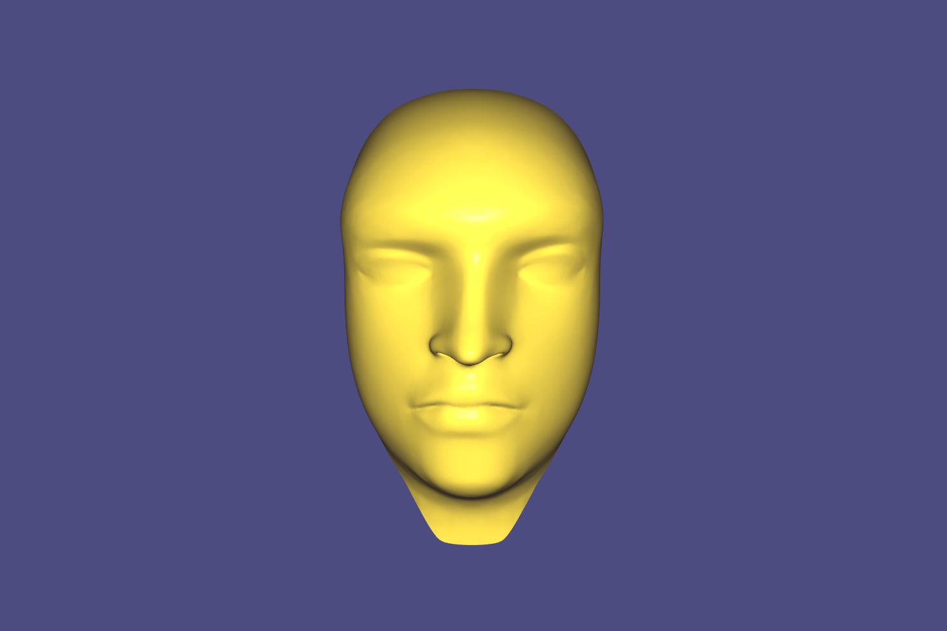
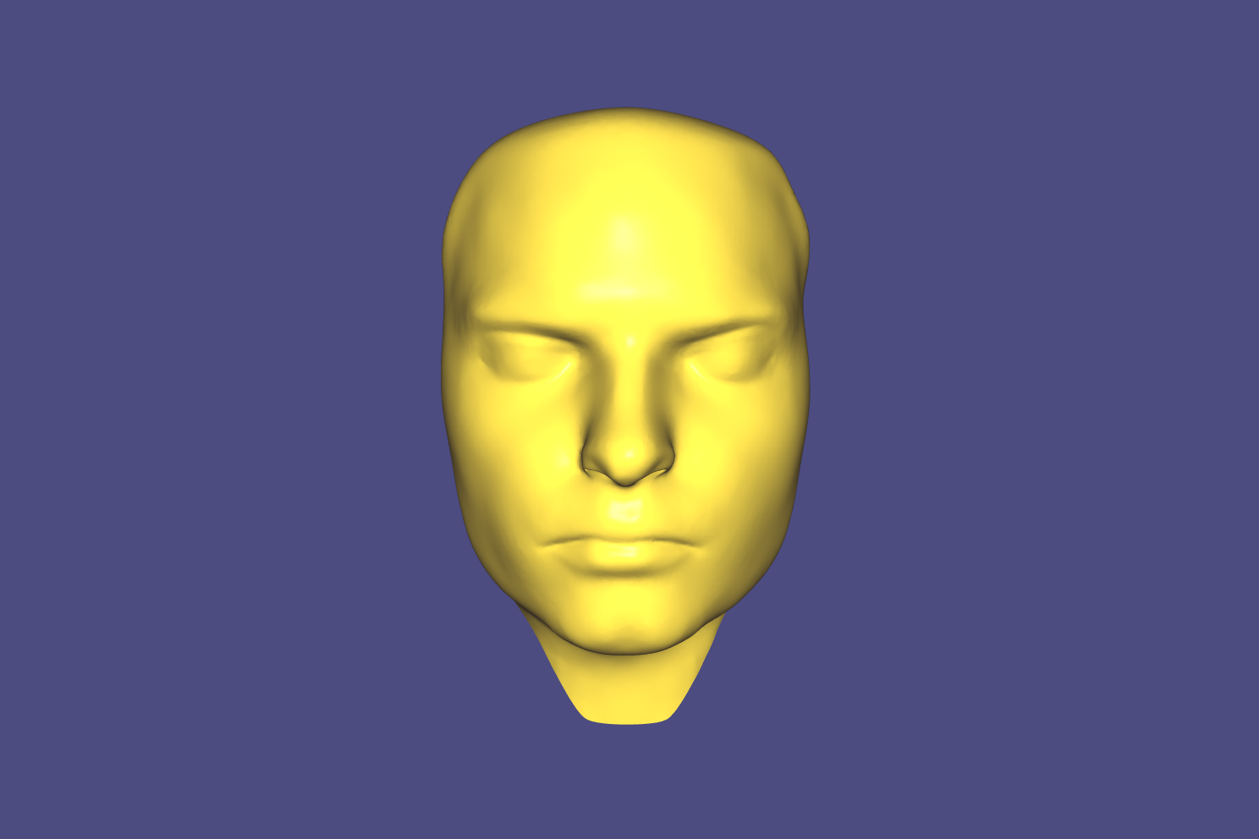
template
after 5 iterations with only landmark constraints + boundary constraints
after 5 iterations with close point constraints + landmark constraints + boundary constraints
Scan

Slide 19
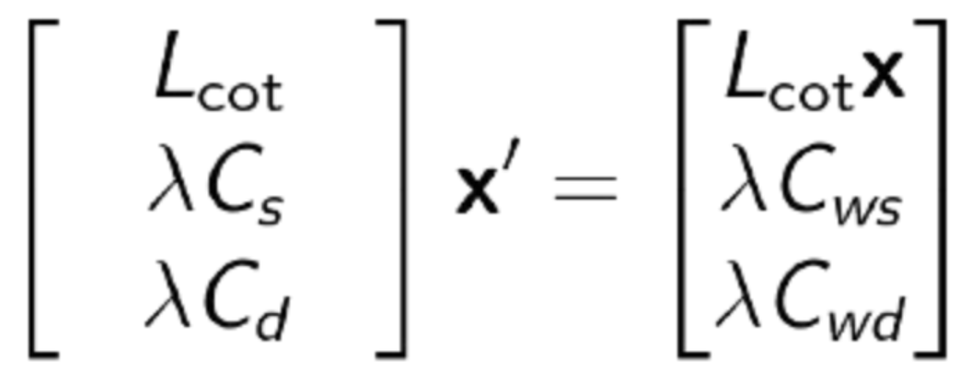
Equations for non-rigid-alignment
lagrange equation:
a lot of spikes and discontinuities despite minimizing the laplace energy
assignment 5 method:
worked well for only landmark constraints
lots of discontinuities for closepoints
winner:
Lcot: unweighted cotangent Laplacian
Cs: weights for static constraints (boundary, landmarks)
Cws: weighted coordinates for static constraints (original boundary, target landmarks)
Cd: weights for dynamic constraints (vertices close enough to target face)
Cwd: weighted coordinates for dynamic constraints (points on target)

Slide 20
PCA

Slide 21
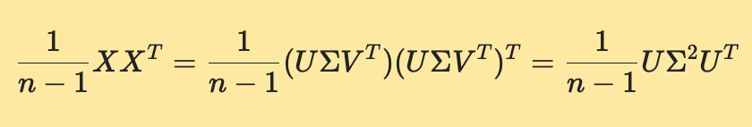
Theory - PCA and SVD

Slide 22
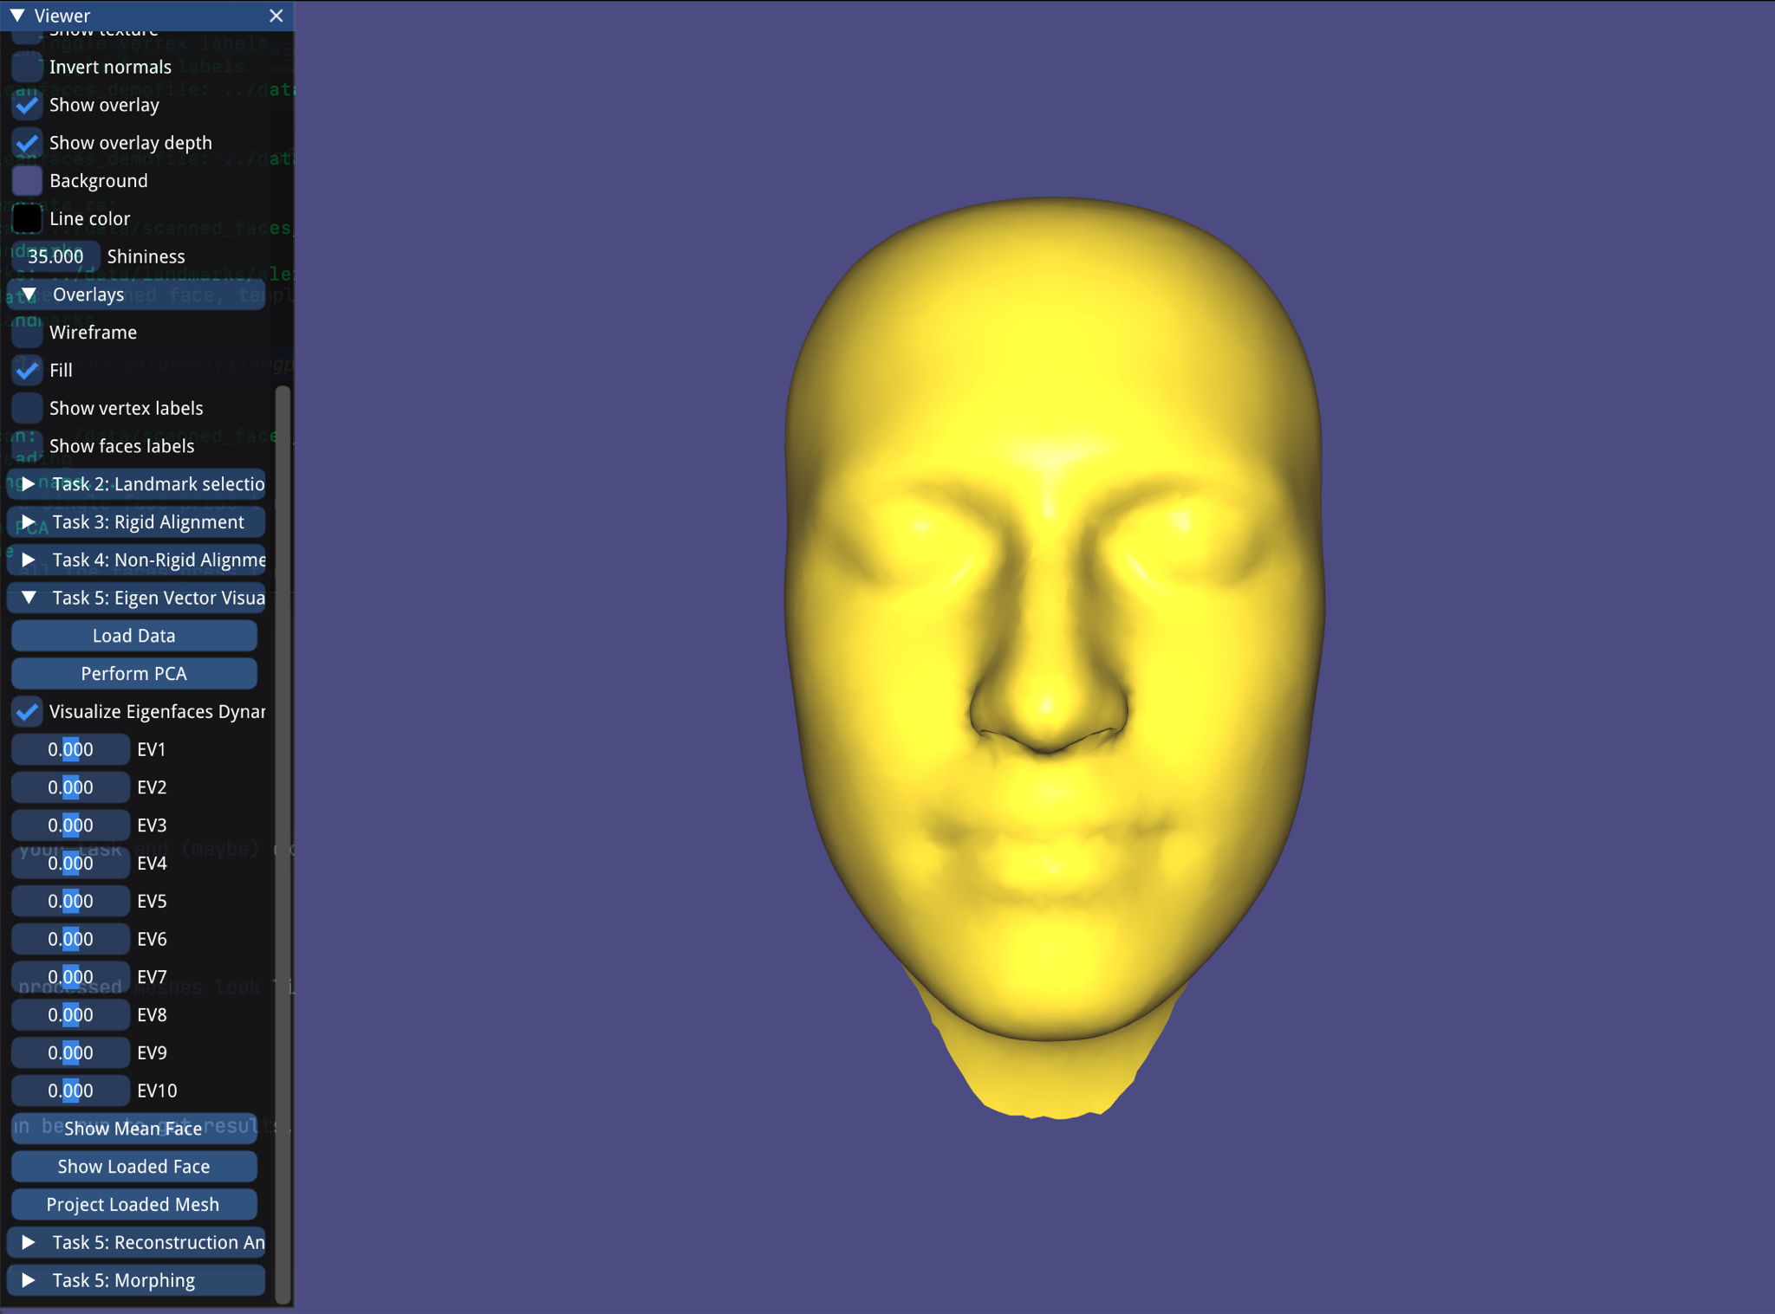
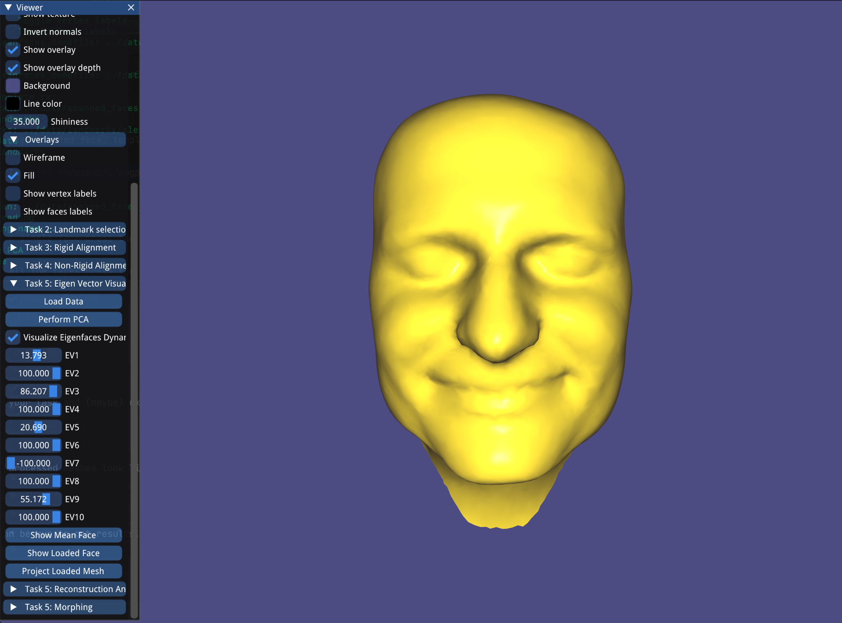
PCA - Eigenvectors

Slide 23
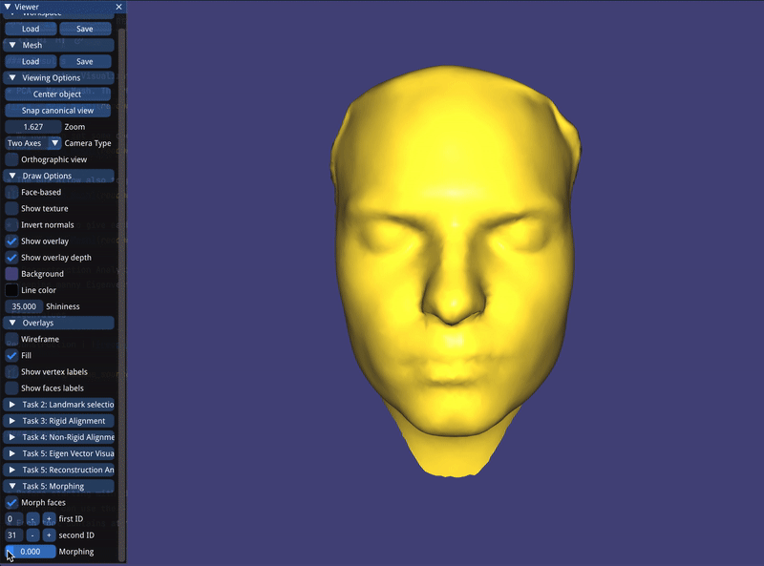
PCA - morphing

